Slide 1
LECTURE SLIDE - 2
Chapter 4: Ohm’s Law, Power and Energy
*
‹#›

Slide 2
Contents
Ohm’s Law
Power
Energy
*
‹#›

Slide 3

4.2 Ohm’s Law
Every conversion of energy from one form to another can be related to the following equation.
In electric circuits, the effect is the flow of charge, or current.
The potential difference, or voltage, between two points is the cause (“pressure”), and
The opposition is the resistance encountered.
*
‹#›

Slide 4
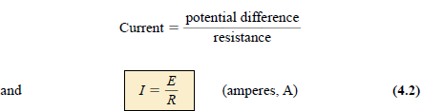
4.2 Ohm’s Law
The following equation is known as Ohm’s Law in honour of Georg Simon Ohm
For a fixed resistance, the greater the voltage across a resistor the more the current.
The more the resistance for the same voltage, the less the current.
In other words, the current is directly proportional to the applied voltage and inversely proportional to the resistance.
*
‹#›
Notes:
‹#›

Slide 5

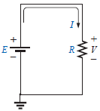

4.2 Ohm’s Law
The voltage and resistance can be found in terms of the other two quantities:
The three quantities of Eqs. (4.2) through (4.4) are defined by the simple circuit:
The symbol E is applied to all sources of voltage
The symbol V is applied to all voltage drops across components of the network.
Since the battery in Fig. 4.2 is connected directly across the resistor, the voltage V_{R} across the resistor must be equal to that of the supply. Applying Ohm’s law:
*
‹#›
Notes:
‹#›

Slide 6
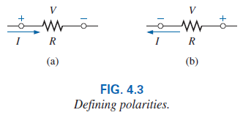
4.2 Ohm’s Law
The voltage source pressures current in a direction that leaves the positive terminal of the supply and returns to the negative terminal of the battery (for single-source networks).
Note also that the current enters the positive terminal and leaves the negative terminal for the resistor R.
For any resistor, in any network, the direction of current through a resistor will define the polarity of the voltage drop across the resistor.
*
‹#›
Notes:
‹#›

Slide 7


4.2 Example 4.1 / 4.2
*
‹#›
Notes:
‹#›

Slide 8
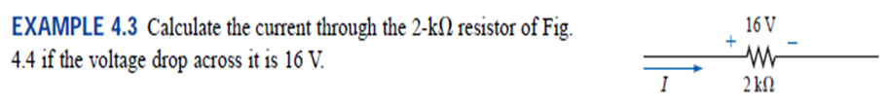

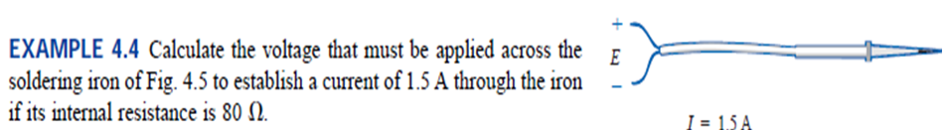
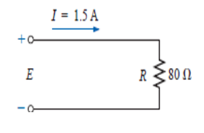

4.2 Example 4.3 /4.4
*
‹#›
Notes:
‹#›

Slide 9
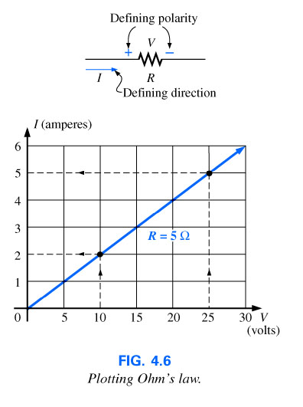
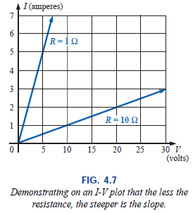
4.3 Plotting Ohm’s Law
*
‹#›
Notes:
‹#›

Slide 10
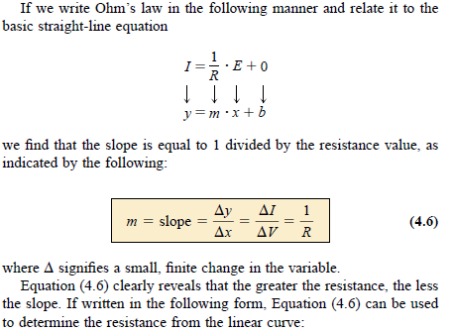
4.3 Plotting Ohm’s Law
*
‹#›
Notes:
‹#›

Slide 11
4.4 Power
Power is an indication of how much work (the conversion of energy from one form to another) can be done in a specified amount of time, that is, a rate of doing work.
A large motor has more power than a small motor because it can convert more electrical energy into mechanical energy in the same period of time.
Since converted energy is measured in joules (J) and time in seconds (s), power is measured in joules/second (J/s).
The electrical unit of measurement for power is the watt (W), defined by:
1 Watt (W) = 1 joule/second (J/s) (4.8)
*
‹#›
Notes:
‹#›

Slide 12

4.4 Power
In equation form, power is determined by
horsepower (hp) is a measure of the average power of a strong dray (small cart) horse over a full working day. It is approximately 50% more than can be expected from the average horse.
The horsepower and watt are related in the following manner:
1 horsepower =746 Watts
*
‹#›
Notes:
‹#›

Slide 13
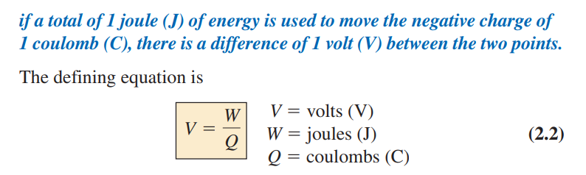

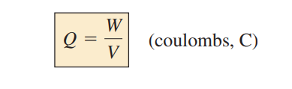
Power
*
‹#›

Slide 14
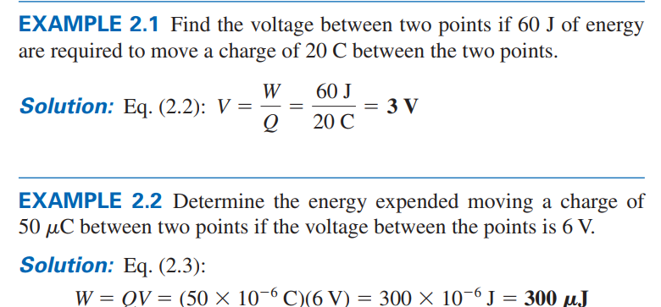
Power
*
‹#›

Slide 15
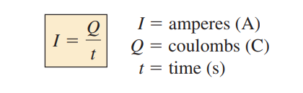
Power
Current (I) is the rate at which the charge is moving which is defined by the following equation:
*
‹#›

Slide 16
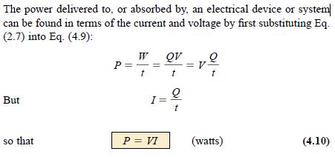
4.4 Power
*
‹#›
Notes:
‹#›

Slide 17
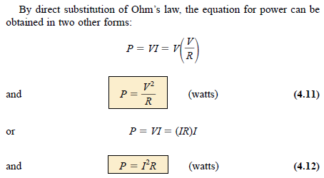
4.4 Power
*
‹#›
Notes:
‹#›

Slide 18
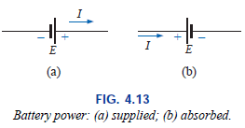

4.4 Power
Power can be delivered or absorbed as defined by the polarity of the voltage and the direction of the current.
For all dc voltage sources, power is being delivered by the source if the current has the direction appearing in Fig. 4.13(a). The current has the same direction as established by the source in a single-source network.
If the current direction and polarity are as shown in Fig. 4.13(b) due to a multisource network, the battery is absorbing power such as when a battery is being charged.
The magnitude of the power delivered or absorbed by a battery is given by
with E the battery terminal voltage and I the current through the source.
*
‹#›
Notes:
‹#›

Slide 19
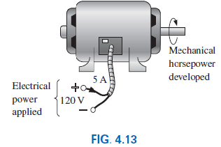

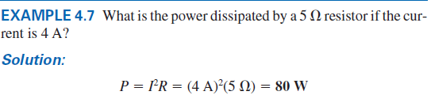
4.4 Power
*
‹#›
Notes:
‹#›

Slide 20
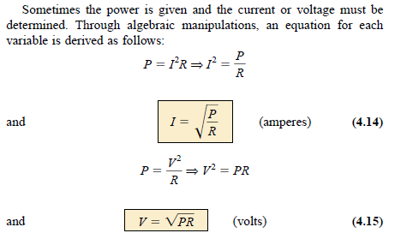
4.4 Power
*
‹#›
Notes:
‹#›

Slide 21

4.4 Example 4.9
Determine the current through a 5-k resistor when the power dissipated by the element is 20 mW.
*
‹#›
Notes:
‹#›

Slide 22
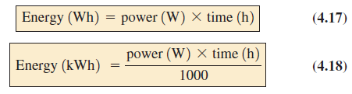
4.5 Energy
The energy (W) lost or gained by any system is therefore determined by
Since power is measured in watts (or joules per second) and time in seconds, the unit of energy is the wattsecond or joule as indicated above.
The watt second, however, is too small a quantity for most practical purposes, so the watt hour (Wh) and kilowatt hour (kWh) were defined, as follows:
*
‹#›
Notes:
‹#›

Slide 23
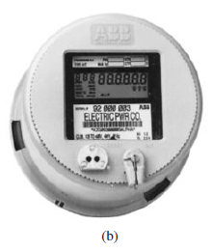
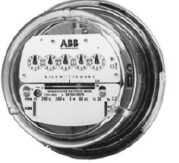
4.5 Energy
The kilowatthour meter is an instrument for measuring the energy supplied to the residential or commercial user of electricity.
It is normally connected directly to the lines at a point just prior to entering the power distribution panel of the building.
*
‹#›
Notes:
‹#›

Slide 24
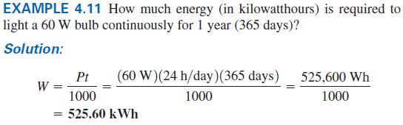
4.5 Example 4.11 / 4.12
*
‹#›
Notes:
‹#›

Slide 25
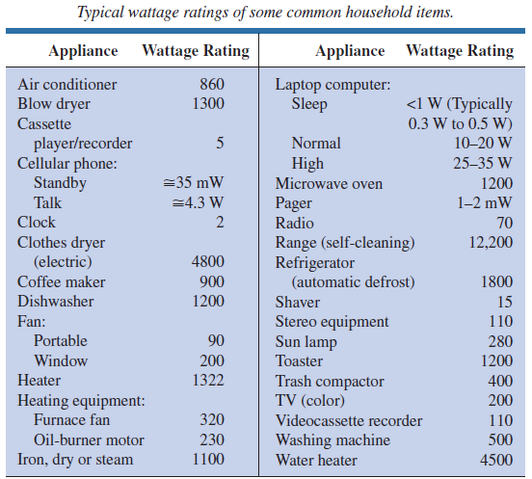
The wattage rating that is given to an device specifying the maximum power within which the device can be safely handled.
*
‹#›
Notes:
‹#›

Slide 26
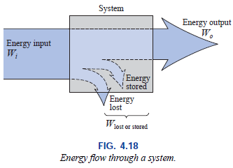
4.6 Efficiency
A flowchart for the energy levels associated with any system that converts energy from one form to another is provided in Fig. 4.18.
The output energy level must always be less than the applied energy due to losses and storage within the system.
*
‹#›
Notes:
‹#›

Slide 27
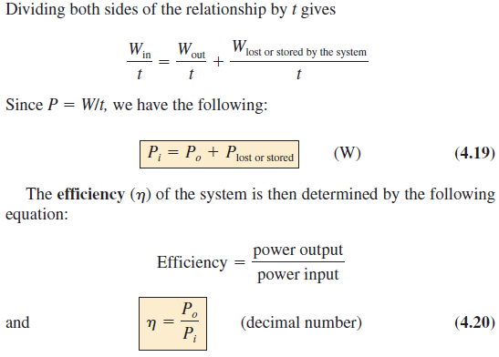
4.6 Efficiency
Energy input = energy output + energy lost or stored in the system
*
‹#›
Notes:
‹#›

Slide 28
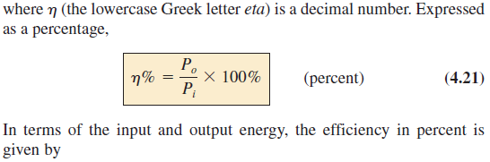
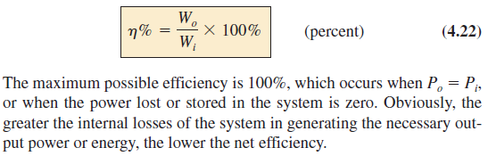
4.6 Efficiency
*
‹#›
Notes:
‹#›

Slide 29
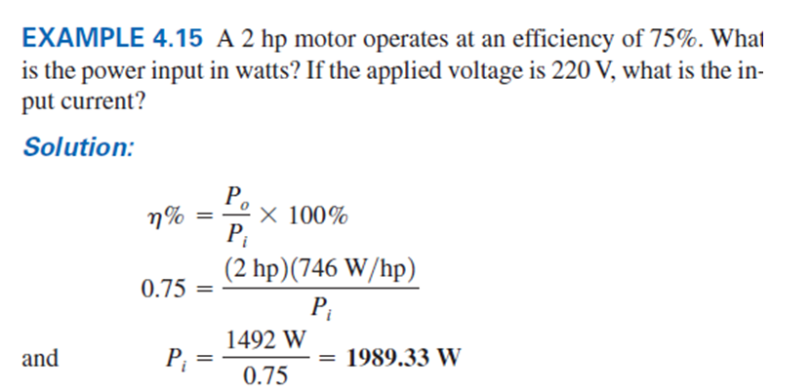

4.6 Example 4.15
*
‹#›
Notes:
‹#›

Slide 30
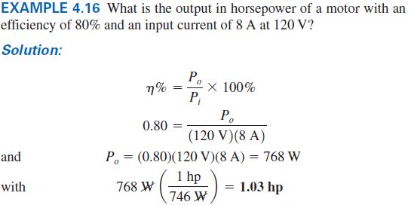
4.6 Example 4.16
*
‹#›
Notes:
‹#›

Slide 31
Thank You
*
‹#›

